Slide 1

AI-Driven Voice Controlled Robot
Project Report by Manus AI | September 15, 2025
Name : Alugoju Vasanthi Meghana
Regd No : 323129512001

Slide 2
Abstract
Hands-Free Robotic Control
This report details a low-cost, AI-driven voice-controlled robot with integrated computer vision. It addresses limitations of traditional control methods by offering a hands-free, intuitive, and efficient alternative. The system uses VOSK for speech recognition, ESP32-CAM for control and video, and Python for high-level functions.
Results show high accuracy, low latency, and robust performance, making it viable for assistive technology, healthcare, and industrial automation.

Slide 3
Introduction: The Need for Intuitive Robotics
Robotics has seen exponential growth, but interaction often relies on physical interfaces like remote controls. This creates limitations for individuals with disabilities, in sterile environments, or in industrial settings where hands are occupied.
This project aims to develop an accessible, affordable voice-controlled robotic solution using AI, speech recognition, and computer vision, leveraging open-source software and low-cost hardware.

Slide 4
Problem Statement: Bridging the Interaction Gap
Traditional robotic control methods require direct manual interaction, making them impractical in critical scenarios like assistive technology, sterile environments, and industrial automation. Existing advanced solutions are often expensive, complex, or cloud-dependent, raising latency and privacy concerns.
Our project proposes a low-cost, efficient, and scalable AI-based alternative using offline voice commands and computer vision to enable natural human-robot interaction.

Slide 5




Proposed Solution: Key Components
Offline Speech Recognition
ESP32-based Robot
VOSK model for local processing, ensuring privacy and low latency.
Built with ESP32-CAM for compact, affordable hardware with Wi-Fi.
Computer Vision
Python Control Application
Integrated for object detection, color recognition, and basic navigation.
High-level interface for voice, vision, and robot communication.

Slide 6
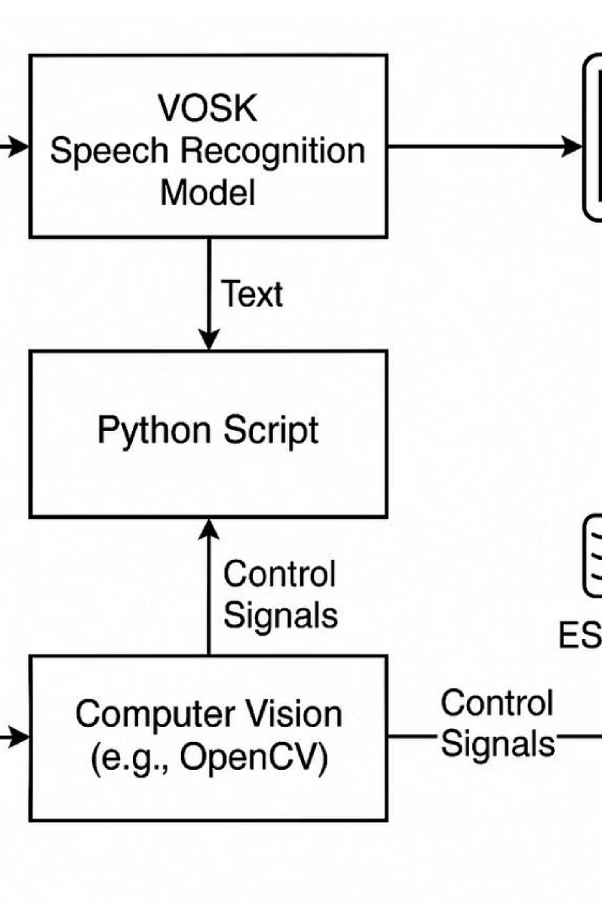
System Architecture: A Modular Approach
The system connects the user, control application, and robot. The control application processes voice commands, interprets them, and sends signals to the ESP32-based robot, which also streams video back for computer vision tasks.
This modular design ensures flexibility, scalability, and ease of maintenance, with dedicated modules for voice recognition, command parsing, computer vision, and robot control.

Slide 7
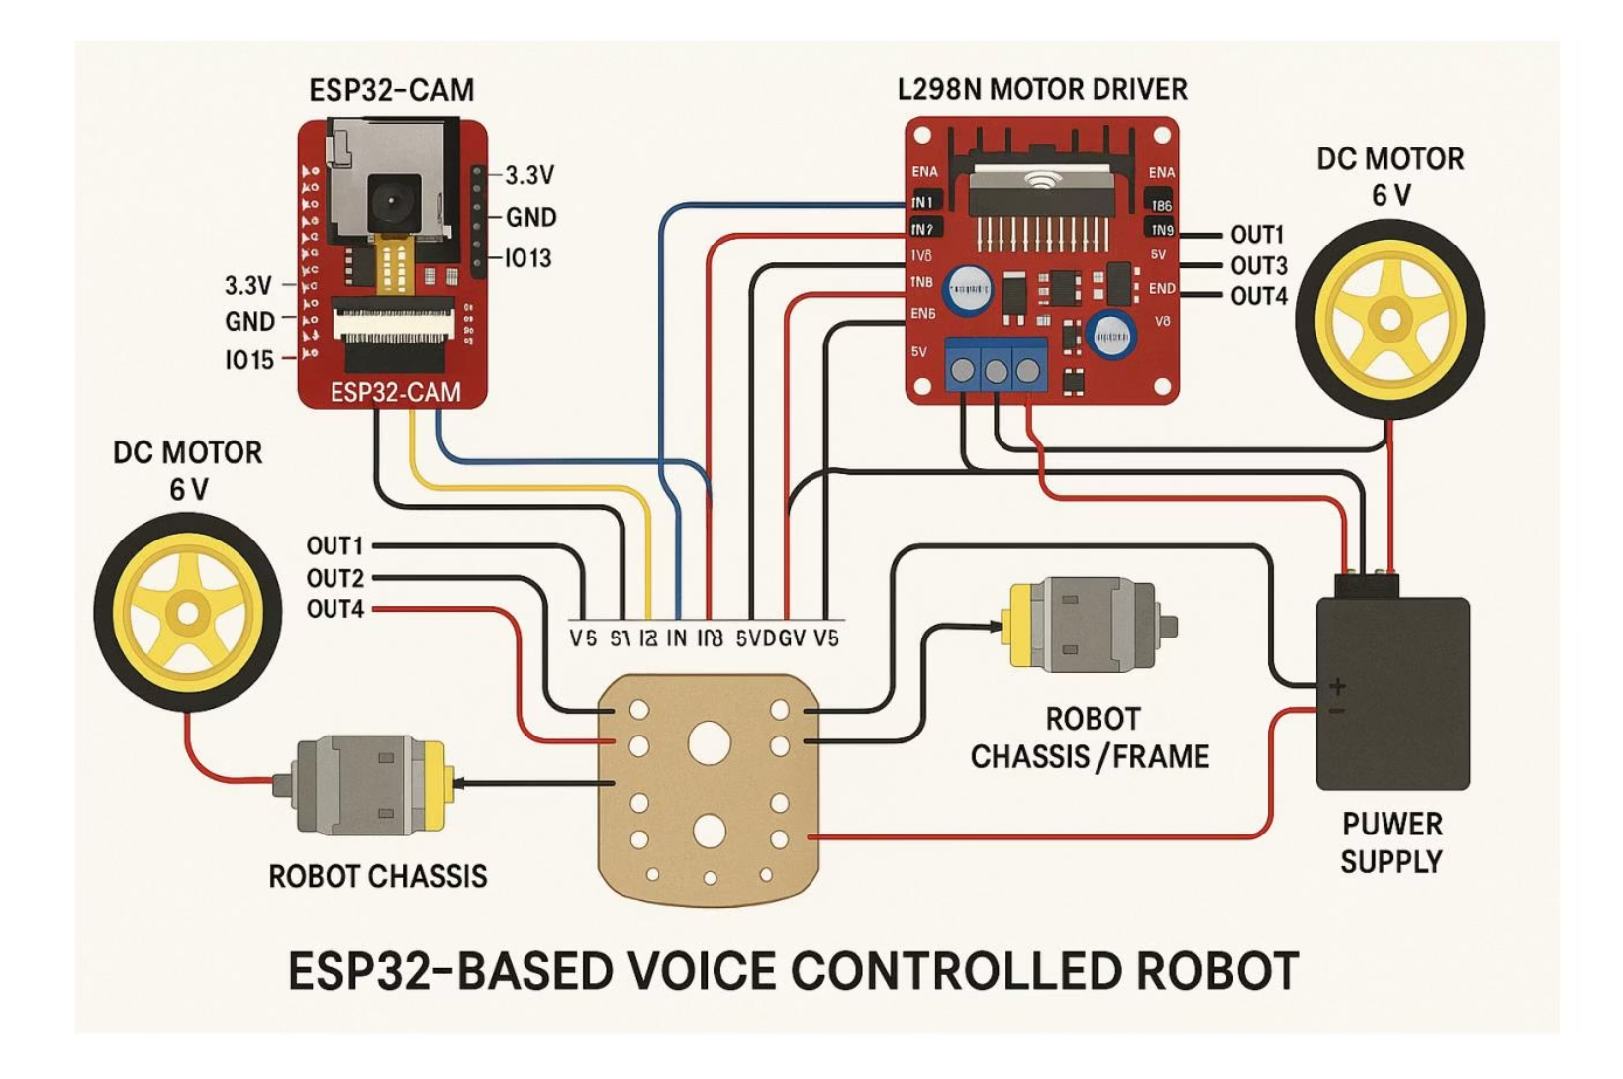
Hardware Implementation
The robot's hardware is designed for low cost and easy assembly. Key components include:
ESP32-CAM: Robot's brain, Wi-Fi, camera, processing.
L298N Motor Driver: Controls two DC motors.
DC Motors: Provide robot mobility.
Robot Chassis: Lightweight platform for components.
Power Supply: Battery pack for ESP32-CAM and motors.

Slide 8
Testing & Evaluation: Performance Metrics
95%
100%
233ms
100+
Speech Recognition Accuracy
Command Parsing Accuracy
Average Response Time
MTBF (Hours)
Mean Time Between Failures, indicating high reliability.
In quiet environments; 85% in noisy settings.
Ensuring precise command interpretation.
From command to robot execution, meeting real-time needs.
Comprehensive testing confirmed the system's accuracy, speed, and reliability across unit, integration, and system tests.

Slide 9
Ethical Considerations: Our Approach
Privacy & Data Security
Safety & Reliability
Bias & Fairness
Offline-first processing for voice and video data ensures local control and minimizes cloud transmission risks.
Obstacle avoidance sensors, robust error handling, and an immediate "stop" command ensure safe operation.
VOSK model trained on diverse datasets to mitigate bias in speech recognition and computer vision.

Slide 10
Conclusion & Future Work
This project successfully demonstrated a low-cost, AI-driven voice-controlled robot with computer vision, leveraging open-source tools for accessibility and power. Its modular design and offline speech recognition provide a solid foundation for future advancements.
Future Enhancements:
Advanced Computer Vision (object tracking, face recognition)
Natural Language Understanding for conversational interaction
Autonomous Navigation with advanced sensors
Robotic arm for object manipulation

